Slide 1
Tableau Sales Dashboard
File created on: 3/1/2019 5:03:20 AM
Bradley Rode

Slide 2
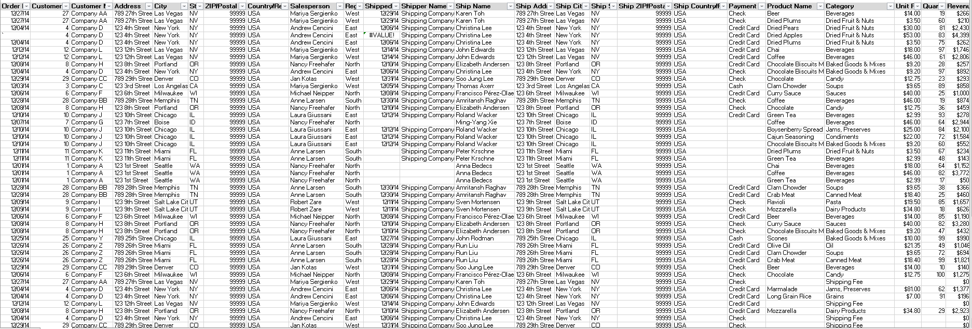
Raw Data from Excel

Slide 3
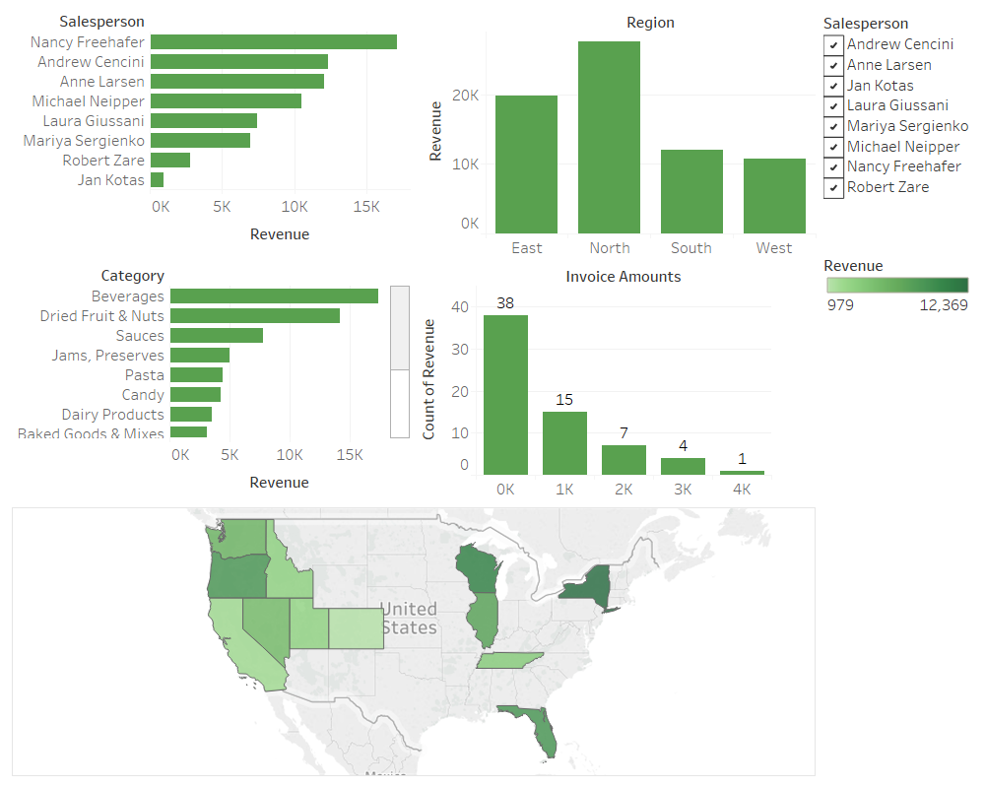

Slide 4
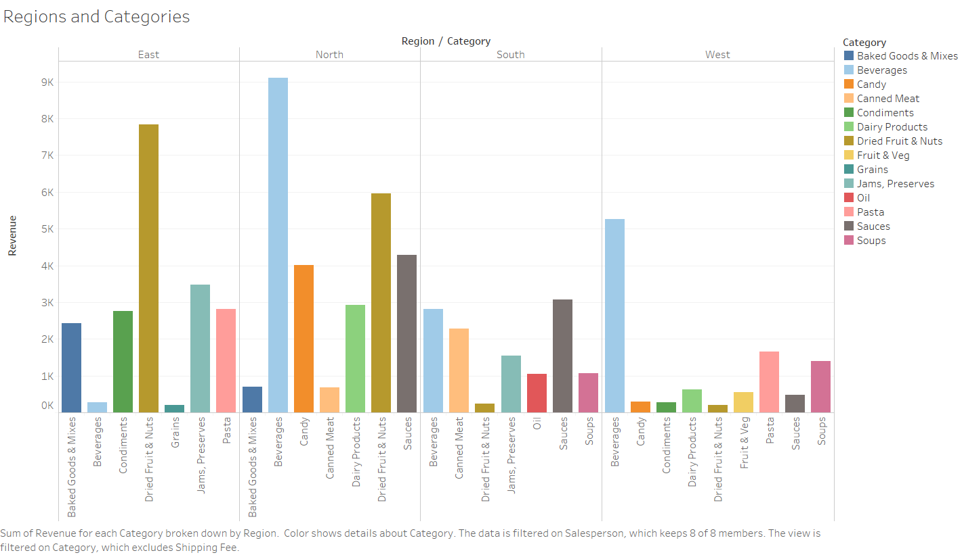

Slide 5
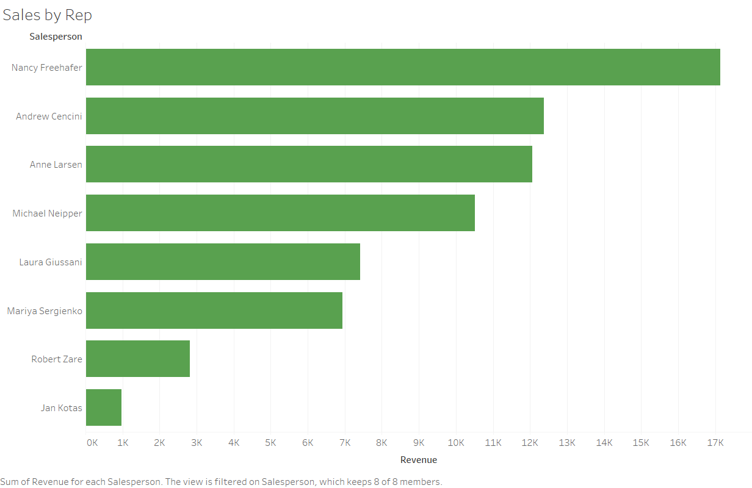

Slide 6
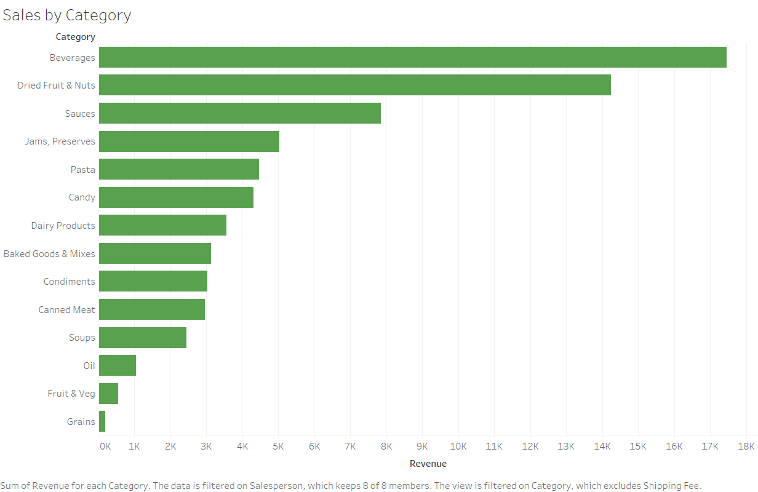

Slide 7
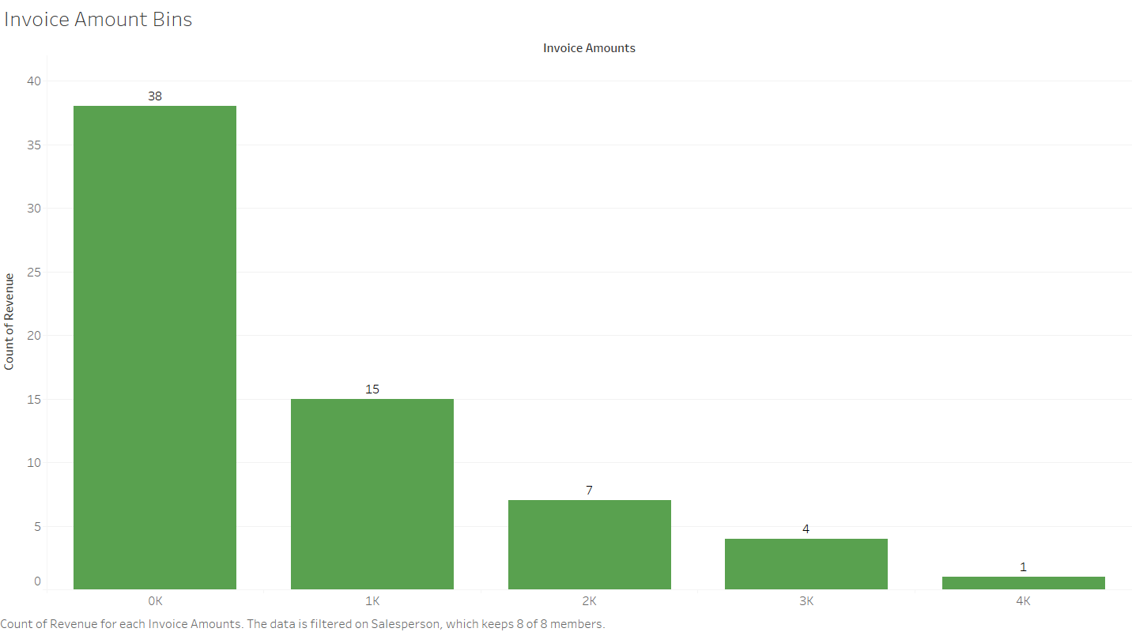

Slide 8
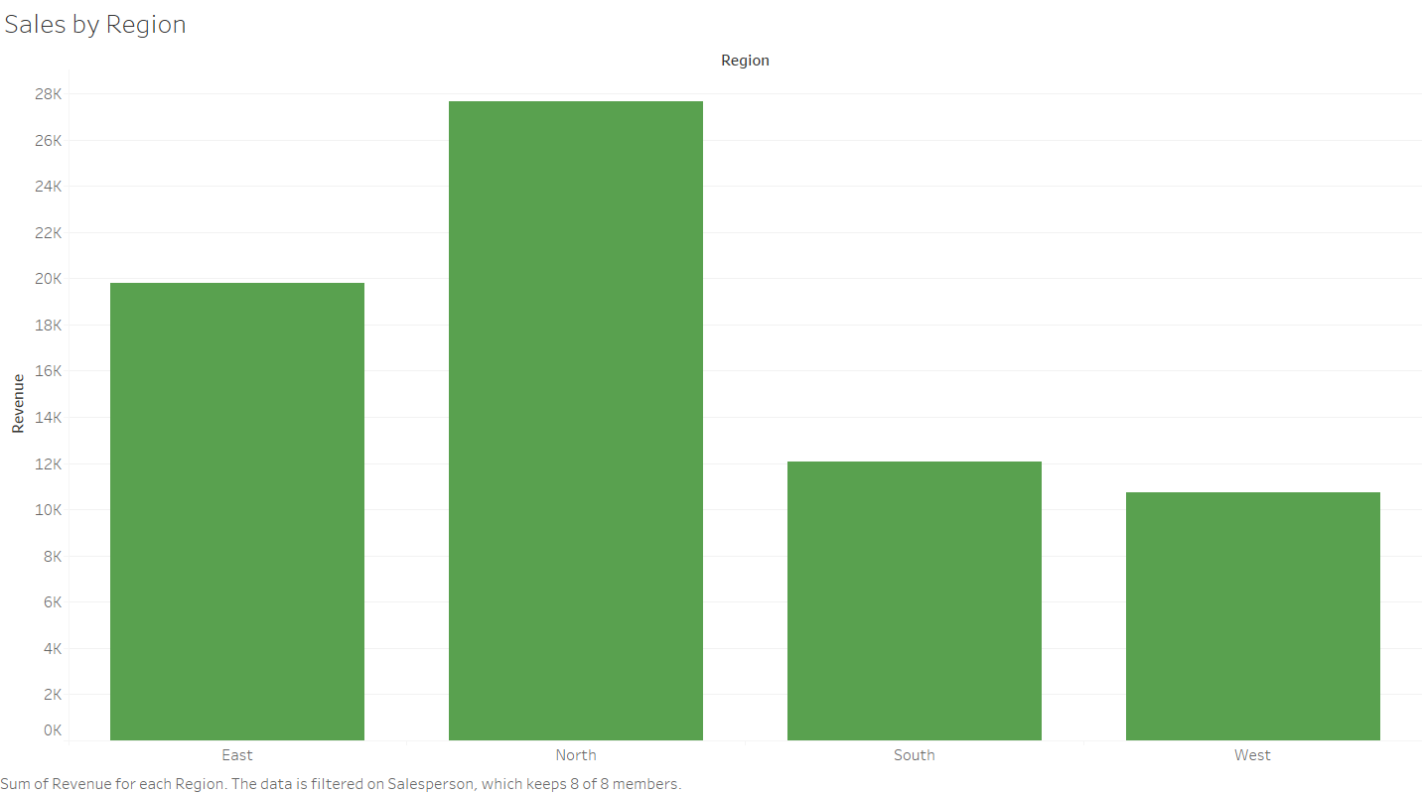

Slide 9
